Slide 1
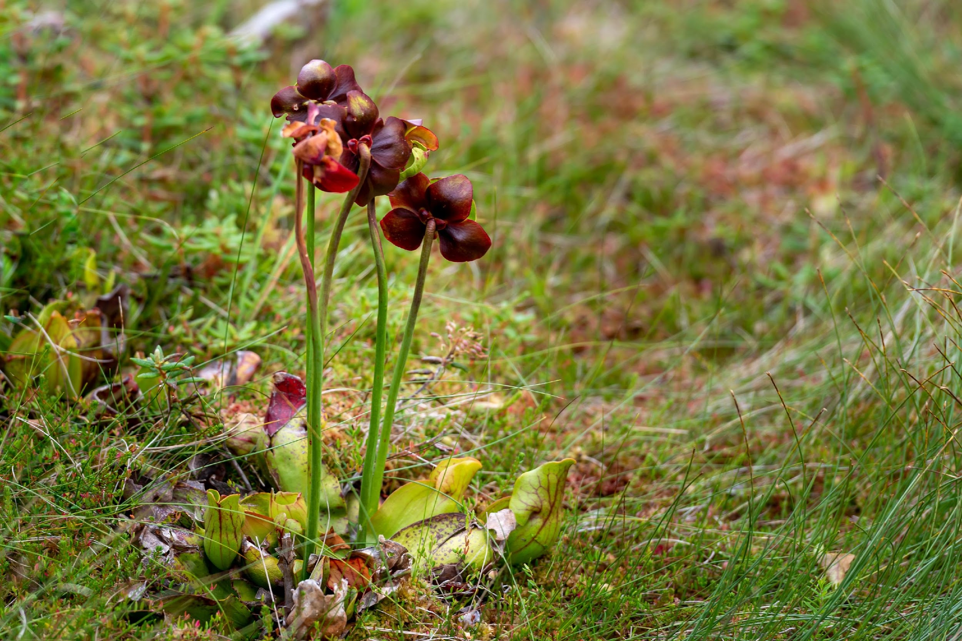
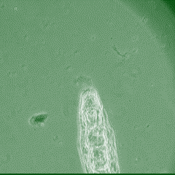

The search for indirect ecological effects of evolution in pitcher plant rotifers
Alex Mendelson
Alex A. Mendelson, Casey P. terHorst
California State University, Northridge

Slide 2
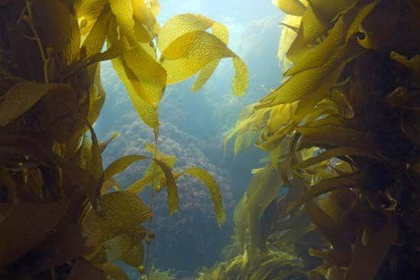
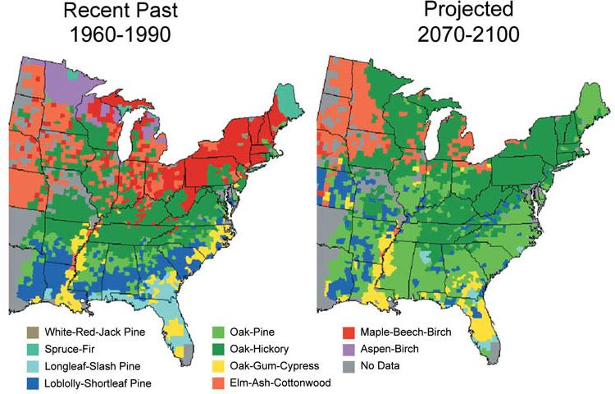
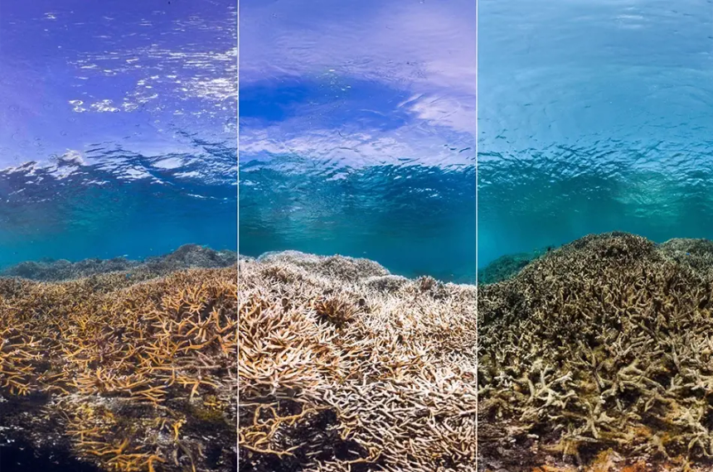
How do you quantify the biological effects of climate change?
Ecological approach
Seasonal processes
Range shifts
Species interactions

Slide 3
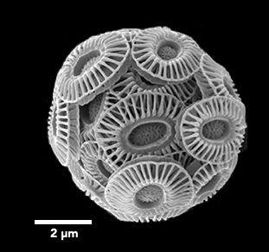
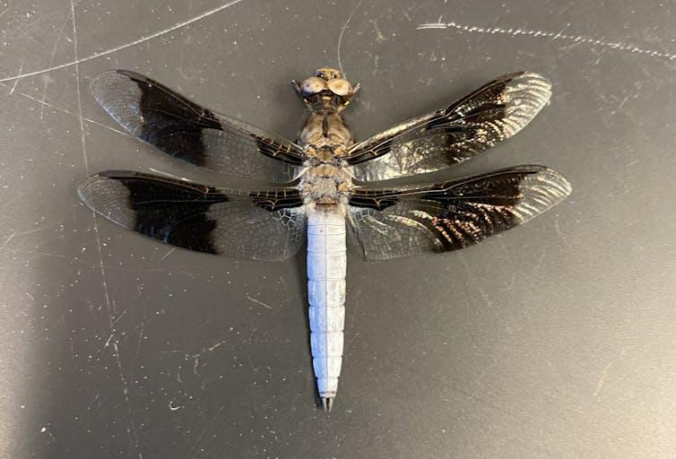
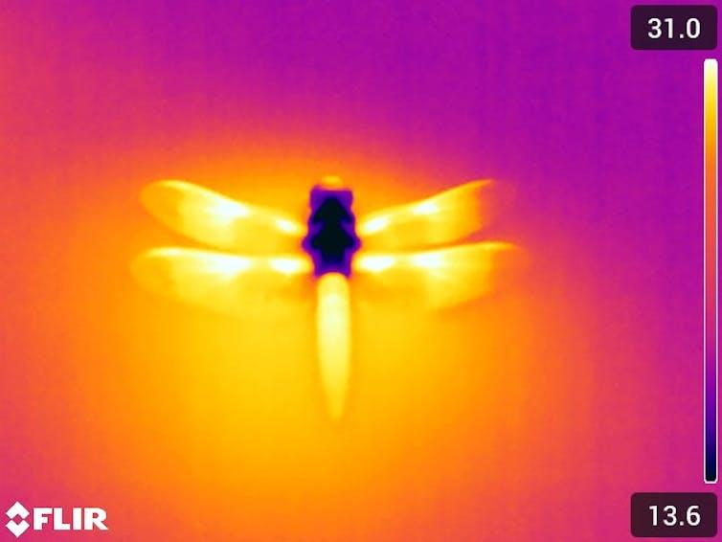
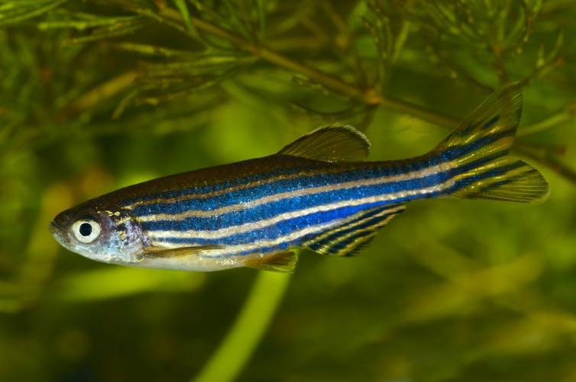
How do you quantify the biological effects of climate change?
Evolutionary approach
Adaptation to ↑pCO₂
Selection trade-offs
Thermal tolerance

Slide 4

Eco-evo effects

Slide 5

Eco-evo effects
Species A
Species B
Higher Temp
Interaction
Climate Change
evolution
Evolution-mediated
Indirect effect

Slide 6
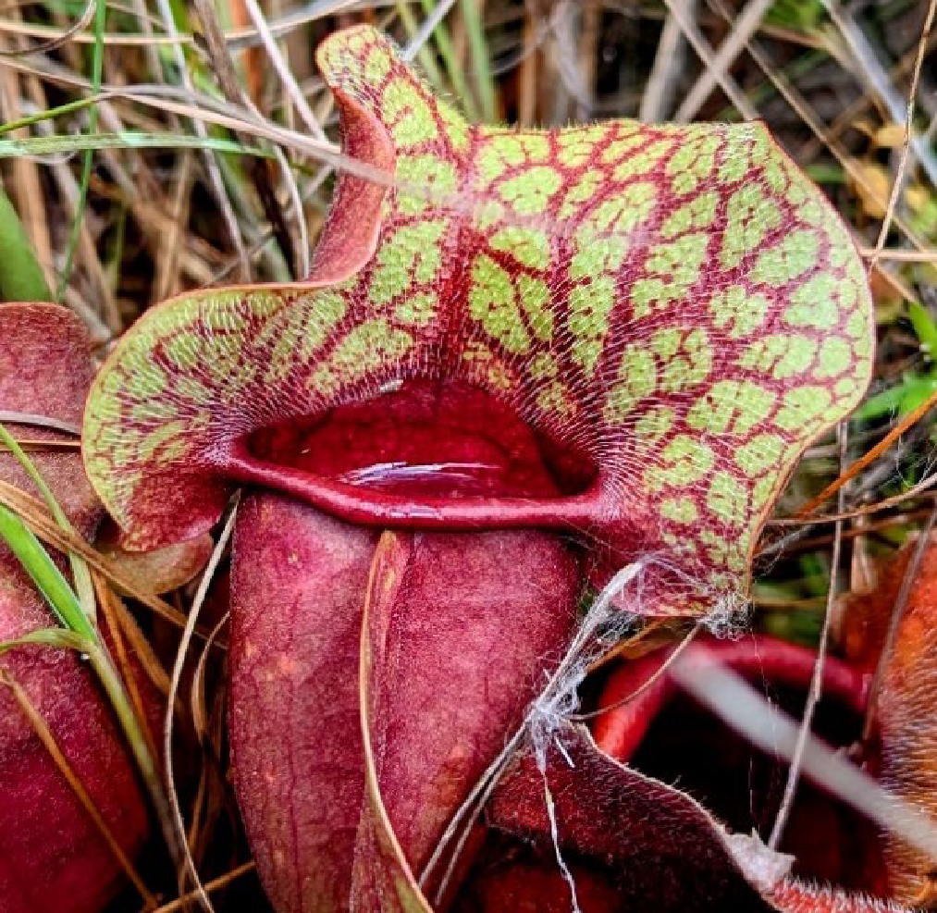
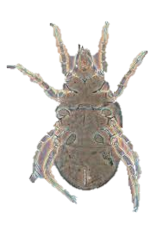
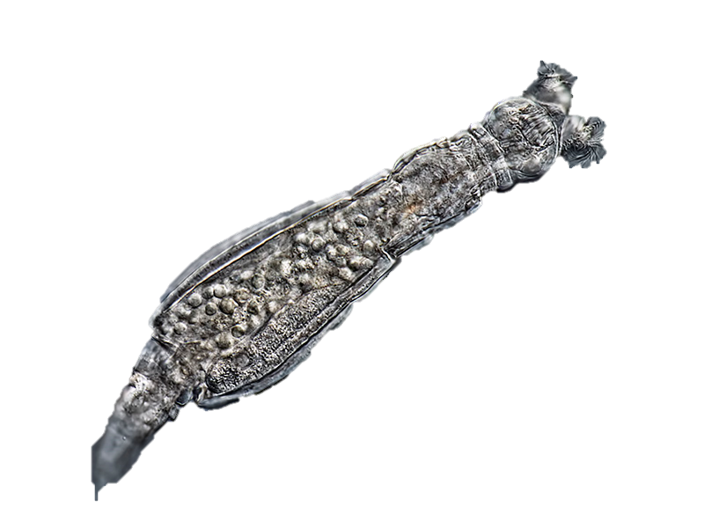
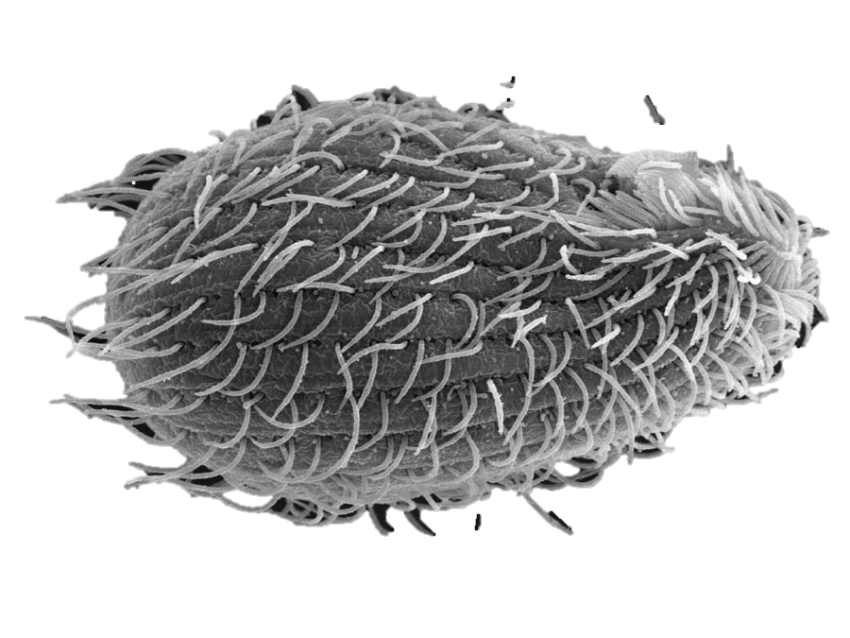

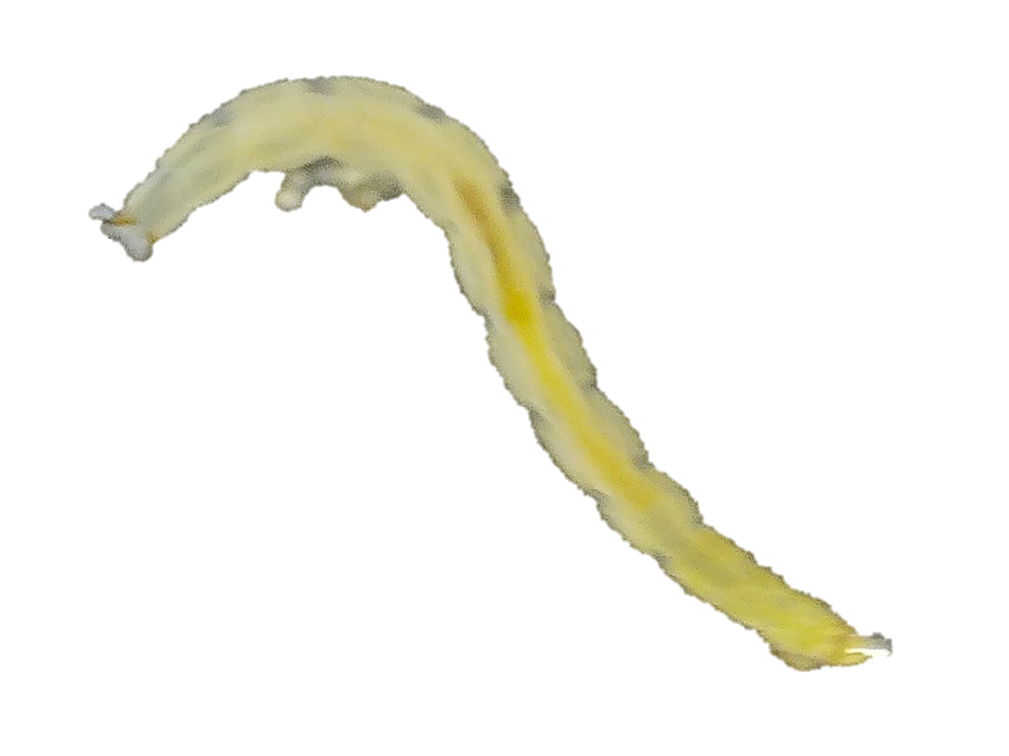
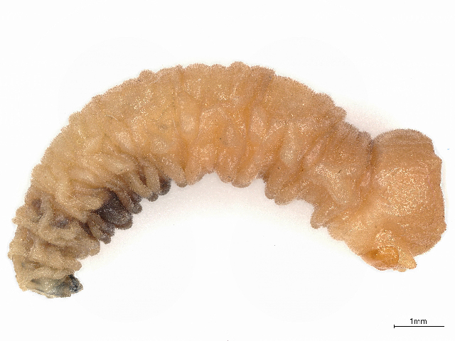
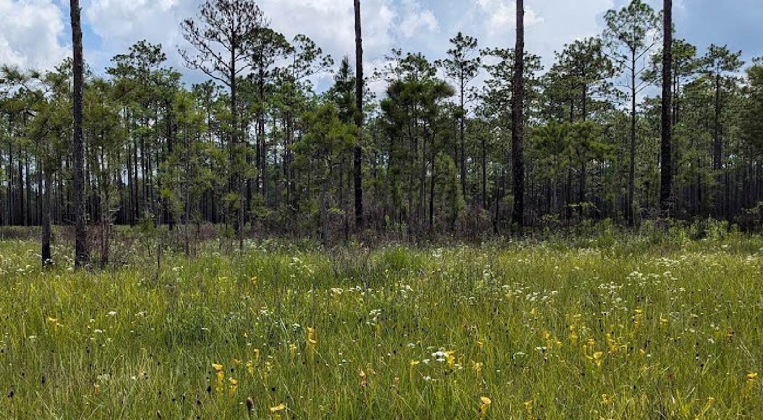
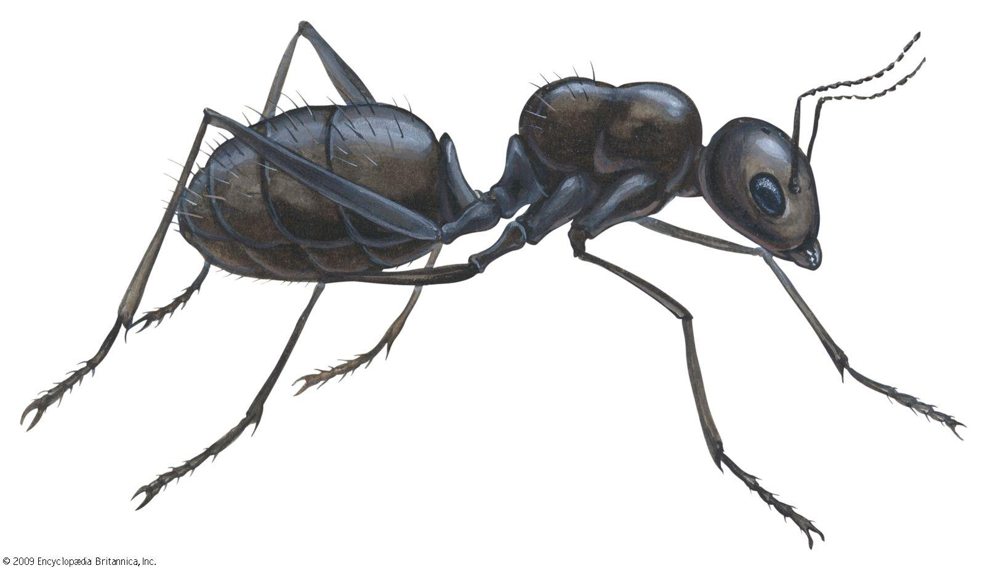
Pitcher plant leaf water community
Bacterivores
Omnivores
Rotifers
Protists
Mites
Bacteria
Sarracenia purpurea
Detritivores
Purple pitcher plant
Prey
Midge & Fly Larvae

Slide 7
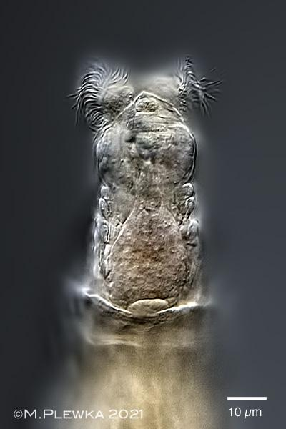
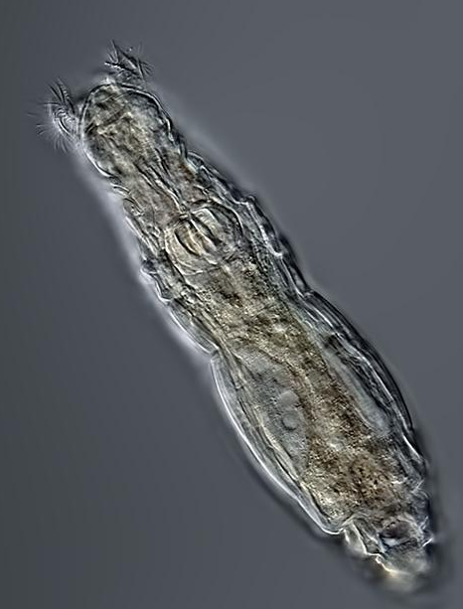
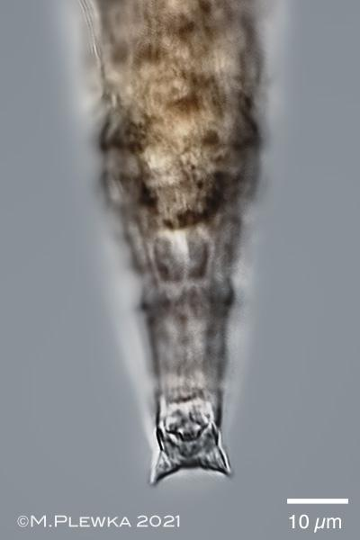
Habrotrocha rosa
Bacterivores
Rotifers
Protists
Michael Plewka
Bacteria
Prey
25 µm
Michael Plewka
Michael Plewka

Slide 8
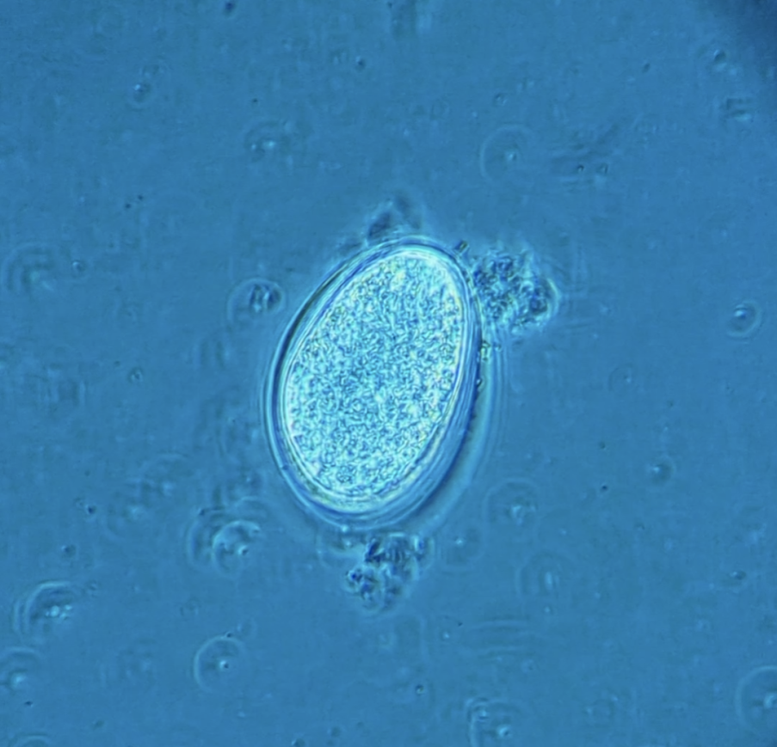
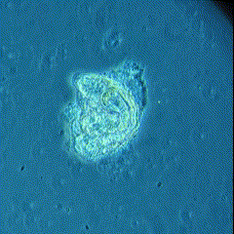
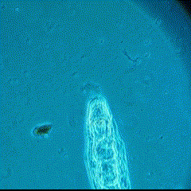
Habrotrocha rosa
Obligately parthenogenetic (apomixis) Offspring are clonal
Generation time 1–2 days
Egg (~6 hours)
Hatching (~12 hours)
Adult (~24-48 hours)

Slide 9
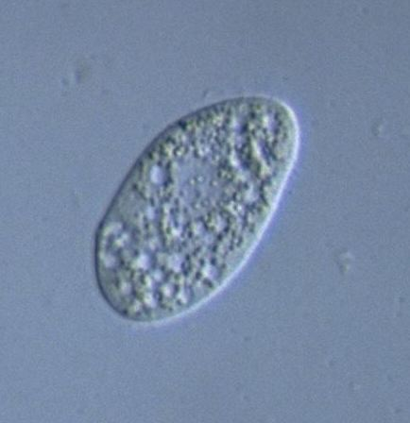
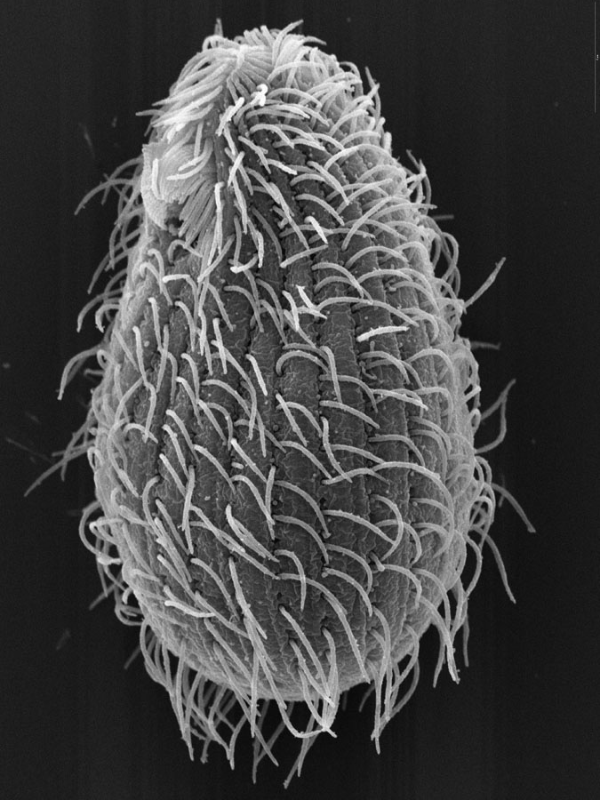
Natural competitor: Tetrahymena
Bacterivores
Competition
Rotifers
Protists
Bacteria
Brian Farley
Y. Tsukii

Slide 10
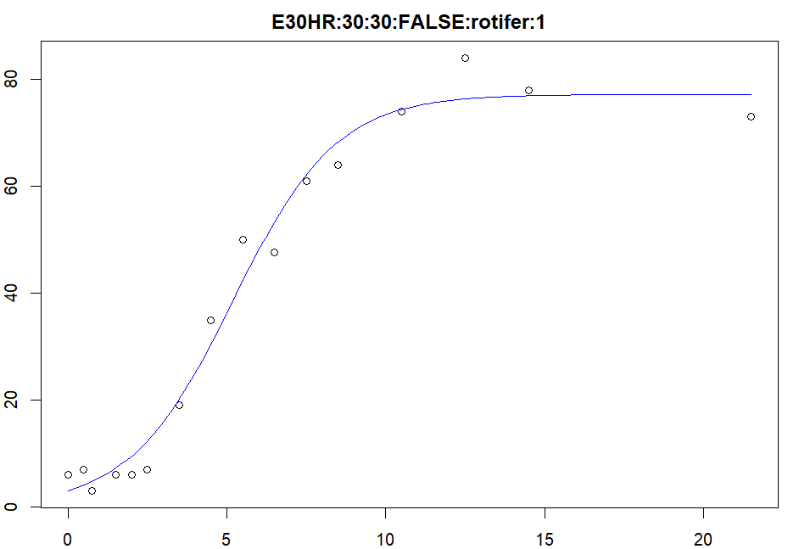


Measuring response to temperature with growth parameters
Logistic growth curve
Logistic growth model predicts:
Maximum growth rate (r)
Carrying capacity (K)
Rotifer response to temperature
(Δr and ΔK) differs among clones
- potential for rapid evolution
Competition affects growth parameters in both rotifers and protists - competition is measurable
r = 0.6*
K = 77*
Abundance
Time (d)
*Example parameters
Notes:
Fewer sig figs on r and K
Try full line without breaks, strike day labels, with all 16 timepoints

Slide 11
Rotifers
Protist
Higher Temp
Competition
evolution
Climate Change
?₁
Indirect effect
Do populations of H. rosa evolve in response to temperature?

Slide 12
?₂
Do H. rosa and Tetrahymena compete?
Rotifers
Protist
Higher Temp
Competition
evolution
Climate Change
?₁
Indirect effect
Do populations of H. rosa evolve in response to temperature?

Slide 13
?₂
Do H. rosa and Tetrahymena compete?
Rotifers
Protist
Higher Temp
Competition
evolution
Climate Change
?₁
Indirect effect
?₃
Are there evolution-mediated indirect effects of temperature on competition between H. rosa and Tetrahymena?
Do populations of H. rosa evolve in response to temperature?

Slide 14
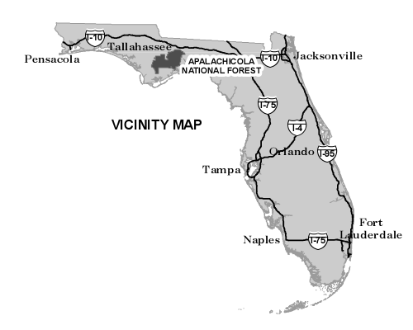
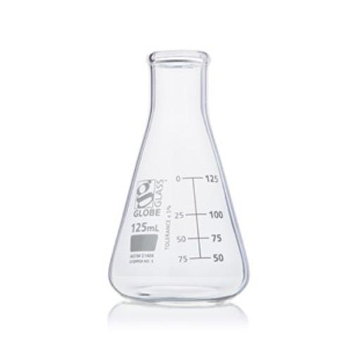

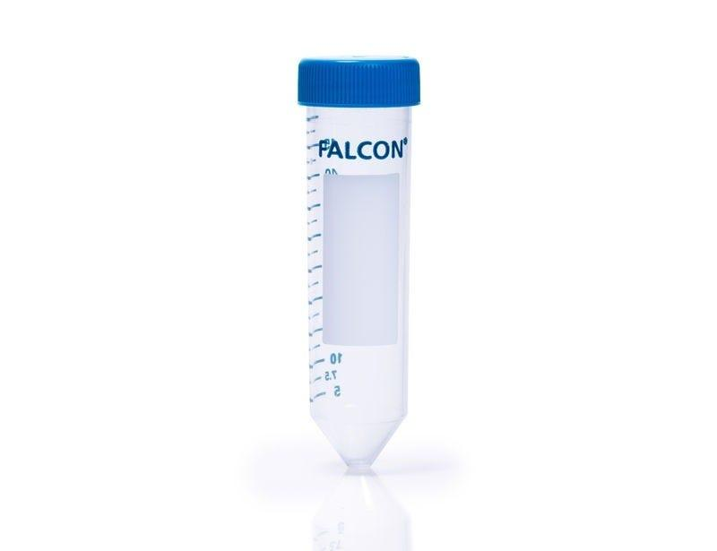
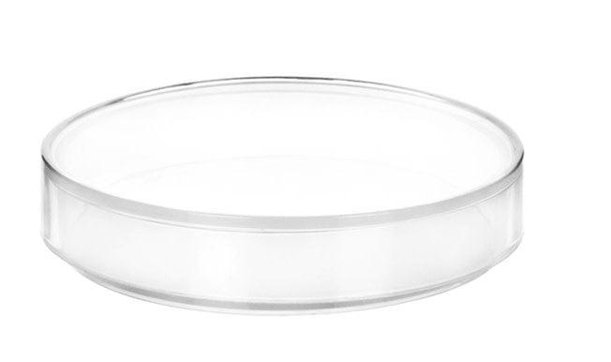
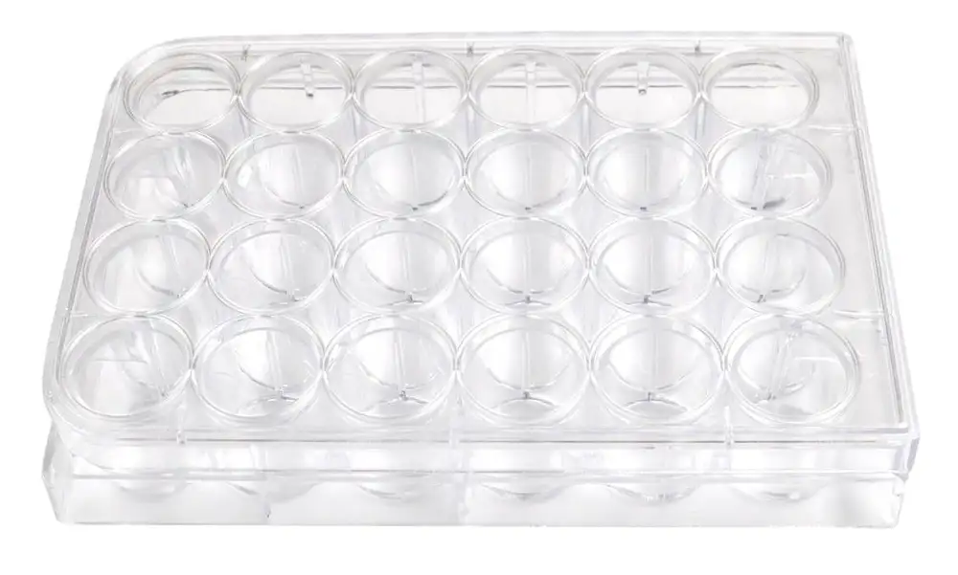
Field Sampling and Isolation
Clonal Cultures
Apalachicola
National Forest
Leaf water
1st Isolation
2nd Isolation

Slide 15
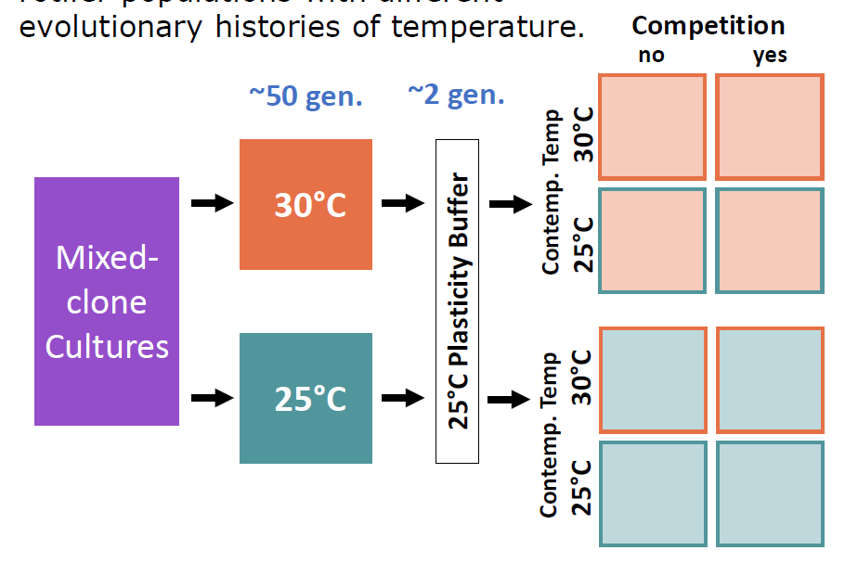
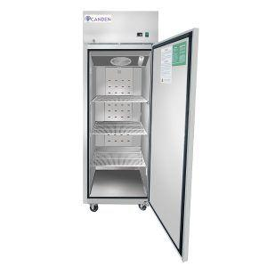

Establishing evolutionary histories of temperature
n = 17 clones were mixed for a diversity in response to temperature
50 generation in growth chambers at 25 °C and 30 °C

Slide 16
Evolution and competition experiment
Common garden setting
Full cross of evolved T, contemporary T, and competition
Tetrahymena sp. also grown alone at 25 °C and 30 °C
Measured abundance over 16 timepoints to model growth parameters
25 °C
Protists only
25 °C
30 °C
25 °C
n = 10
Every 6 h
Every 12 h
Every 1 d
Every 2 d
Every 8 d
d0
d21
Notes:
Mention common garden, replace “plasticity buffer”

Slide 17
Results
Do populations of H. rosa evolve in response to temperature?
Rotifers
Protist
Higher Temp
Competition
evolution
Climate Change
Indirect effect
?₁
Notes:
Break results into two parts: in this first part, we’re addressing whether evolution occurred in response to temperature

Slide 18
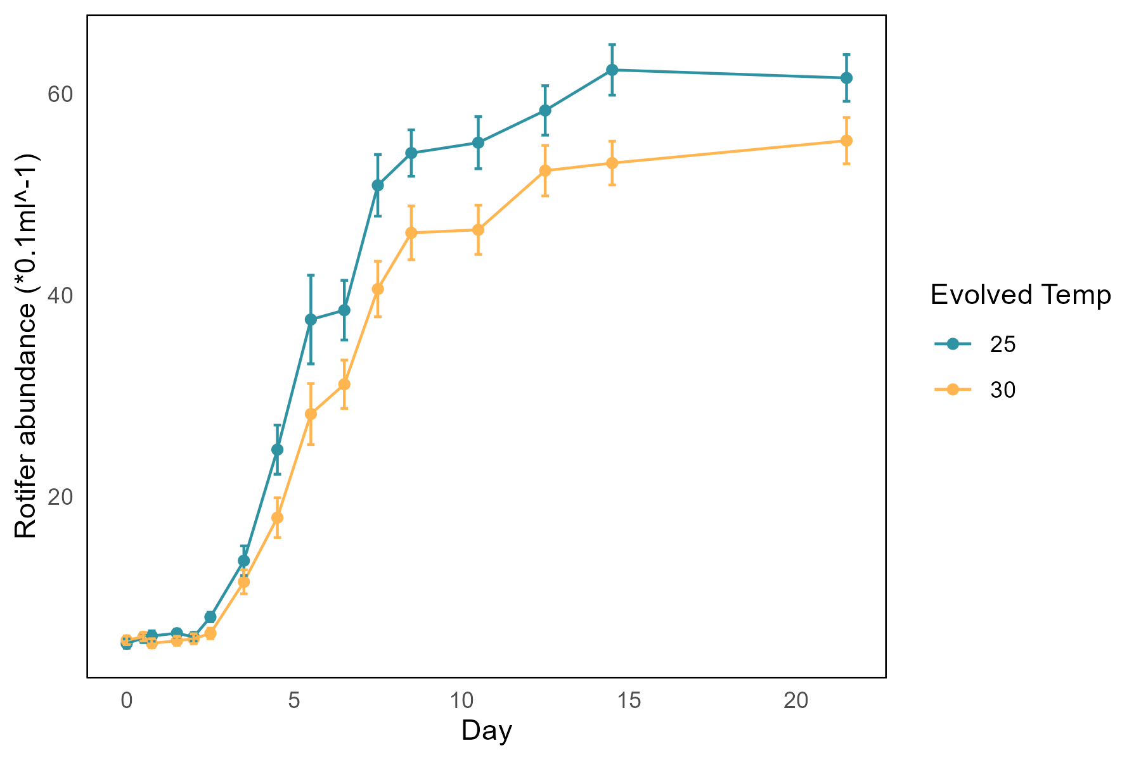
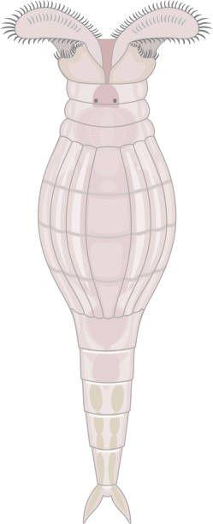
Rotifers had a lower carrying capacity after evolving at 30 °C
Independent of current temperature and competition
K was higher for cultures that evolved at 25 °C compared to 30 °C
p < 0.001
no effect of evolved temperature on growth rate
Rotifer abundance (+/- SE)
p = 0.67
n = 40

Slide 19
Results
II. Competitive response of rotifers to protists
& indirect effects of evolution
?₂
Rotifers
Protist
Higher Temp
Competition
evolution
Climate Change
Indirect effect
?₃

Slide 20
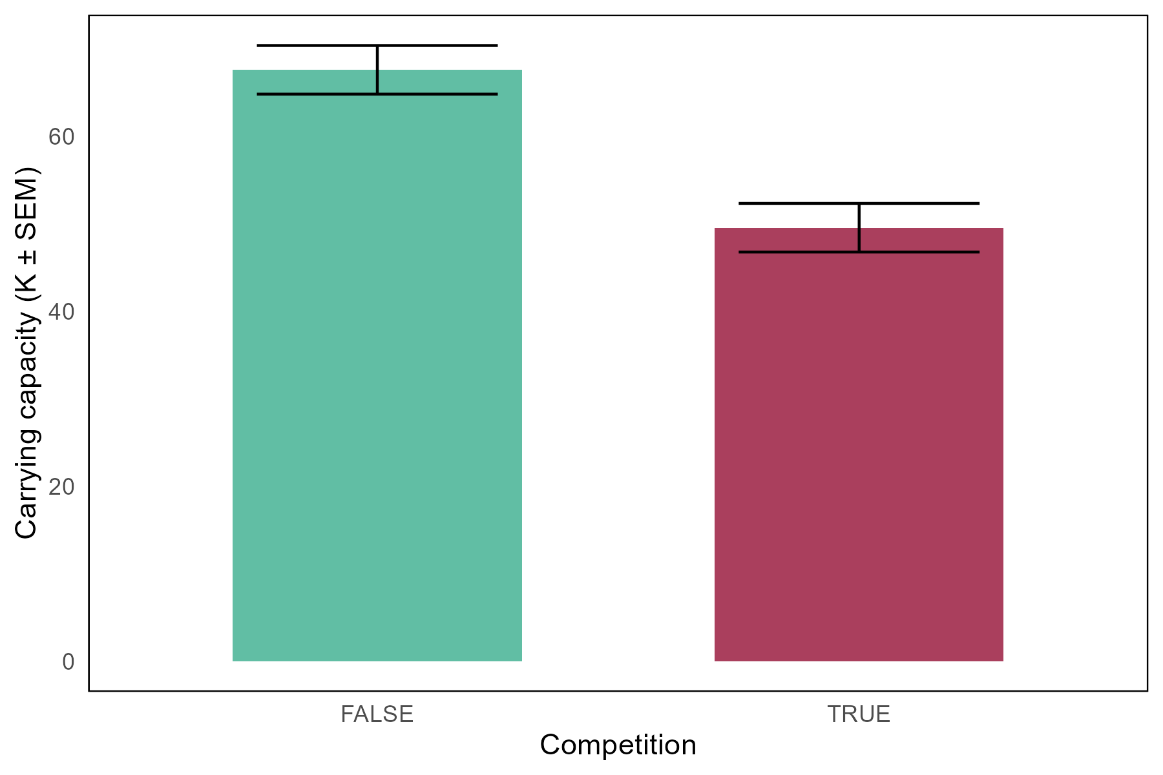
Rotifers experiencing competition had a lower carrying capacity
Carrying capacity of H. rosa
Independent of current temperature and evolution
K was lower for cultures experiencing competition
n = 40
p < 0.001
No competition
Competition
Notes:
Dots? Line color would be weird. No line?

Slide 21
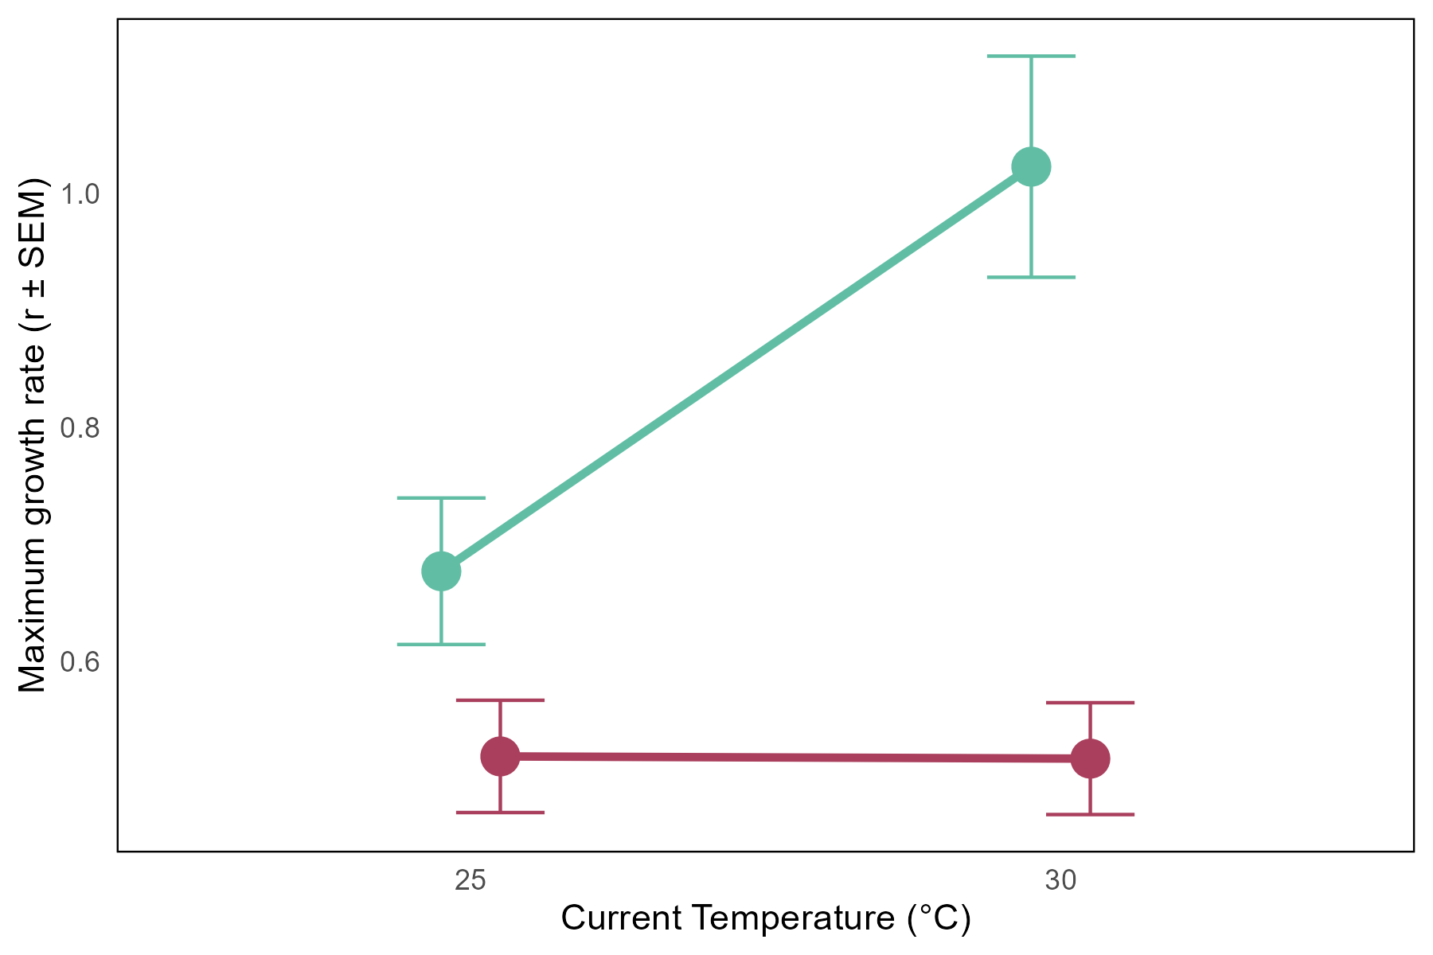
Effect of competition on rotifer r depended on current temperature
Growth rate of H. rosa
Growth rate lower in the competition treatment at both current temperatures
Effect size dependent on temperature
Evolution had no effect on competitive response in rotifers
no competition
n = 20
competition
p = 0.03
Growth rate (r +/- SE)
***
*
25°C
30°C
Current Temperature

Slide 22
Results
III. Competitive effect of rotifers on protists
& indirect effects of evolution
?₂
Rotifers
Protist
Higher Temp
Competition
evolution
Climate Change
Indirect effect
?₃

Slide 23
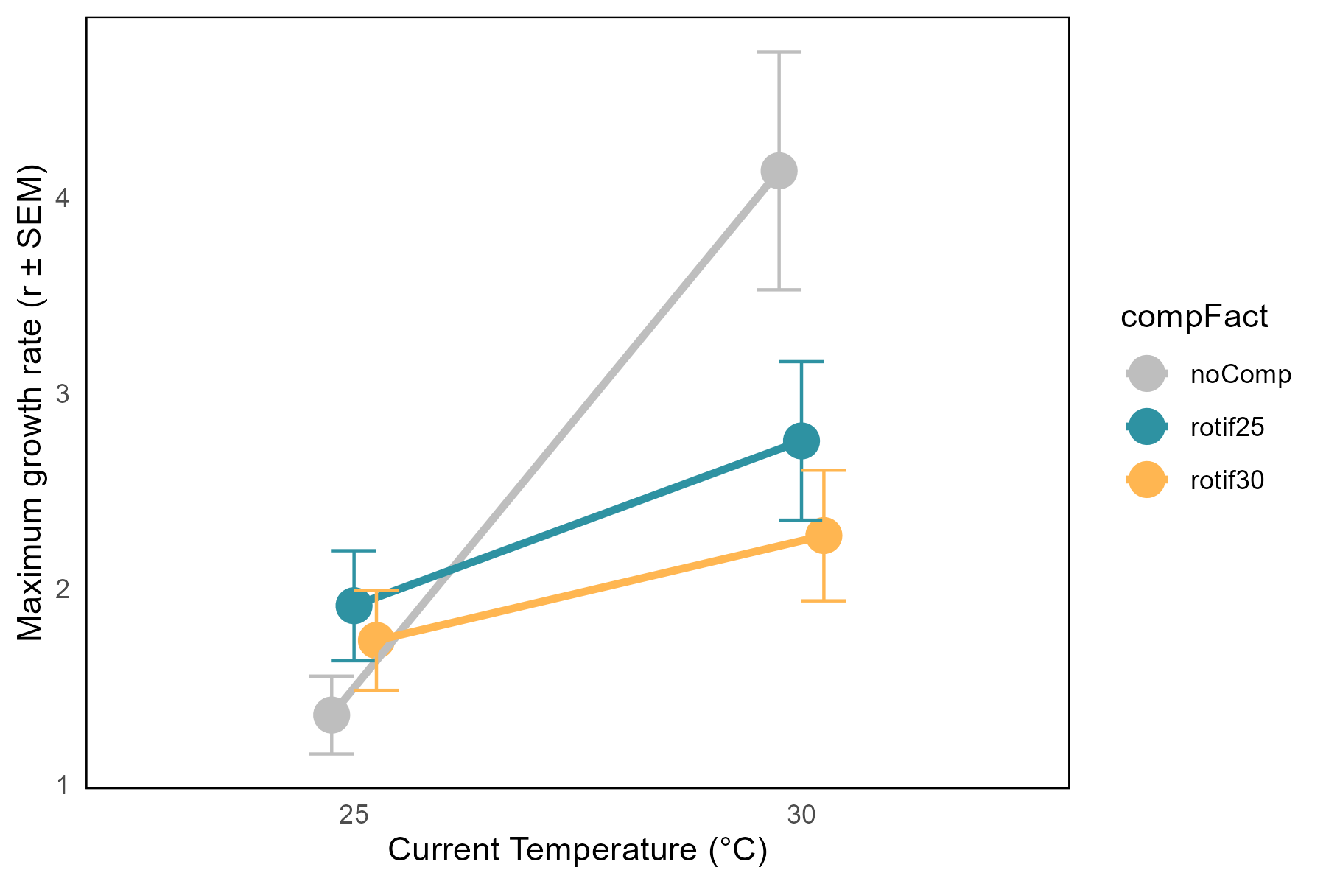
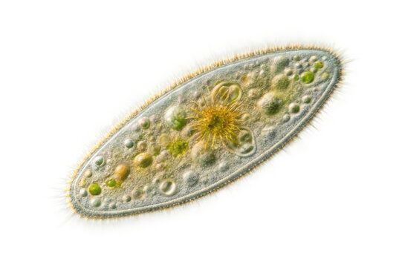
Competitive effect of rotifers on protists dependent on current temperature
Growth rate of Tetrahymena sp.
no competition
n = 20
At 25 °C competition has no effect on protist growth rate
At 30 °C competition lowered protist r
Evolutionary history of rotifers had no effect
comp w/ 25 °C evo. rotifs.
p = 0.01
comp w/ 30 °C evo. rotifs.
*
Growth rate (r +/- SE)
ns
ns
25°C
30°C
Current Temperature

Slide 24
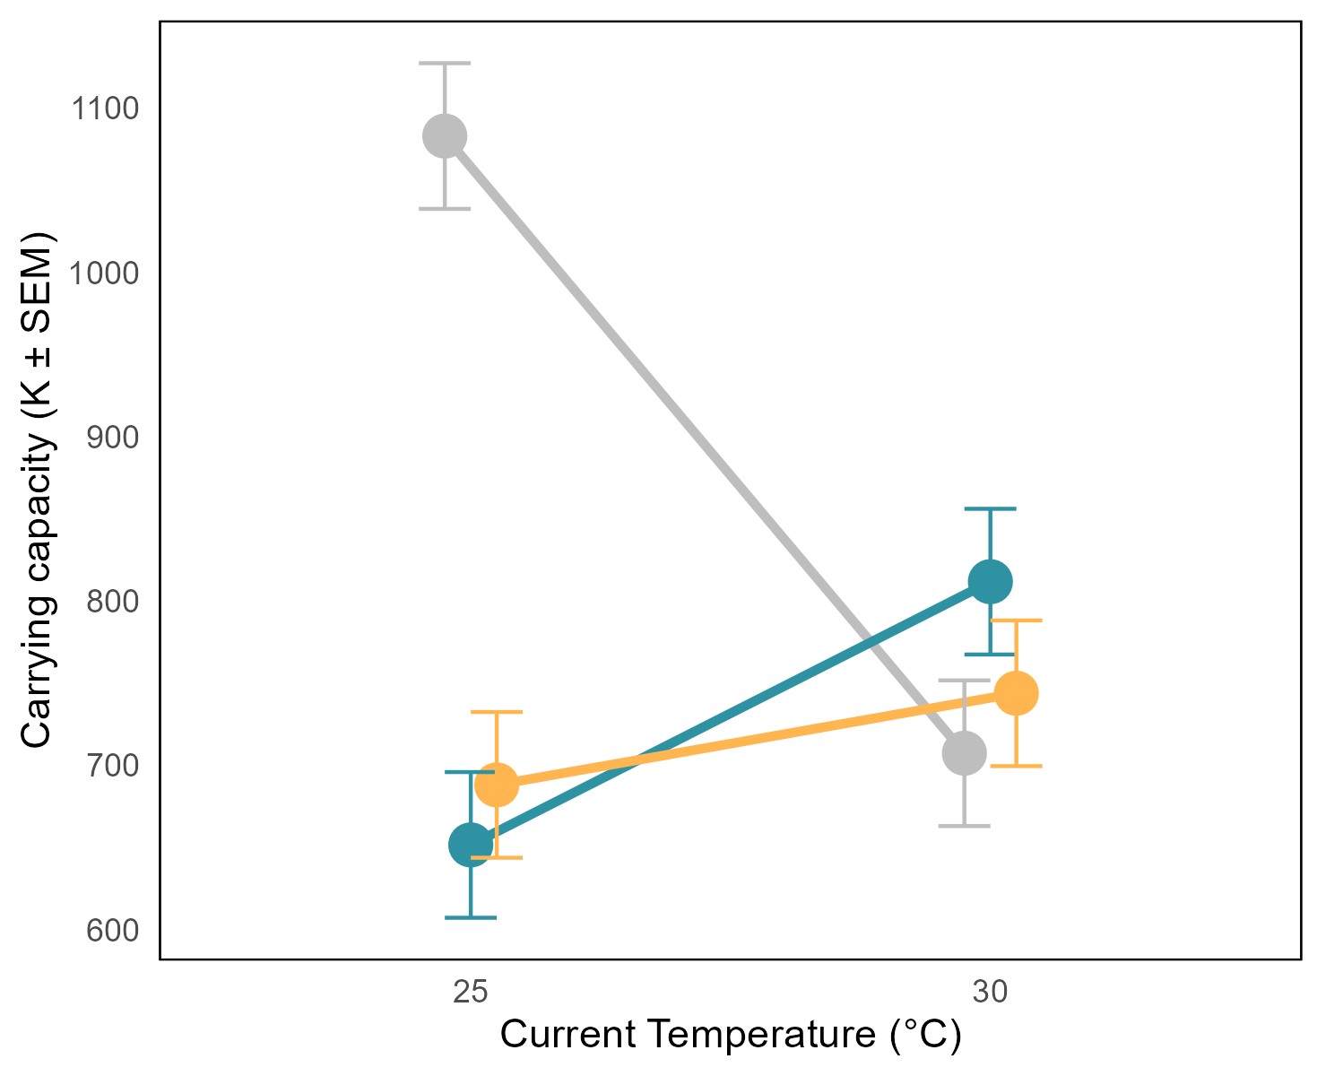
Competitive effect of rotifers on protists dependent on current temperature
Carrying capacity of Tetrahymena sp.
no competition
At 25 °C competition lowered protist K
At 30 °C competition has no effect on protist carrying capacity
Evolutionary history of rotifers had no effect
comp w/ 25 °C evo. rotifs.
comp w/ 30 °C evo. rotifs.
Carrying Capacity (K +/- SE)
***
ns
ns
n = 20
p < 0.01
25°C
30°C
Current Temperature
Notes:
Trend consistent with r-K tradeoff, that’s something more to look into

Slide 25
Growth rate of Tetrahymena sp.
Carrying capacity of Tetrahymena sp.
no competition
n = 20
no competition
comp w/ 25 °C evo. rotif.
p = 0.01
comp w/ 25 °C evo. rotif.
comp w/ 30 °C evo. rotif.
comp w/ 30 °C evo. rotif.
*
***
ns
ns
ns
ns
n = 20
p < 0.01

Slide 26
In summary…
Do populations of H. rosa evolve in response to temperature?
Yes!
Carrying capacity is lower after evolving at 30 °C
2. Do H. rosa and Tetrahymena sp. compete with each other?
It depends…
Effect is dependent on temperature
Are there evolution-mediated indirect effects on competition?
No
Competition did not differ between evolutionary histories of temperature

Slide 27

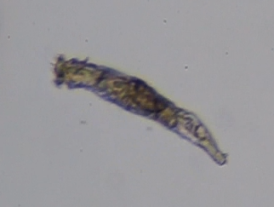

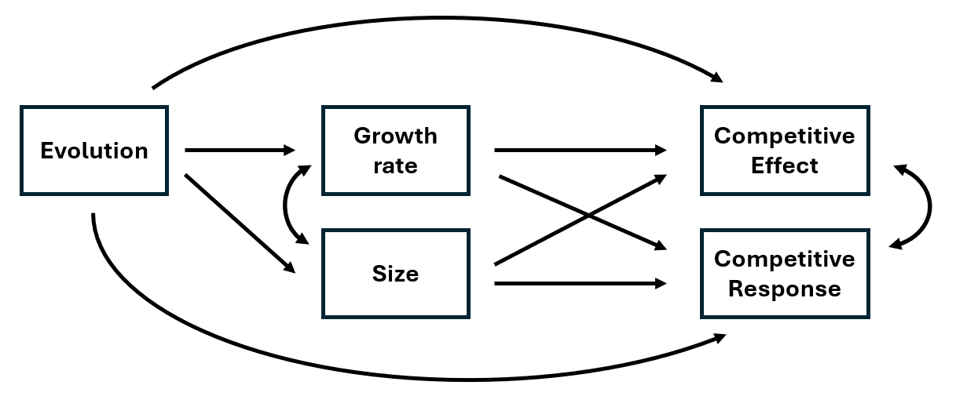
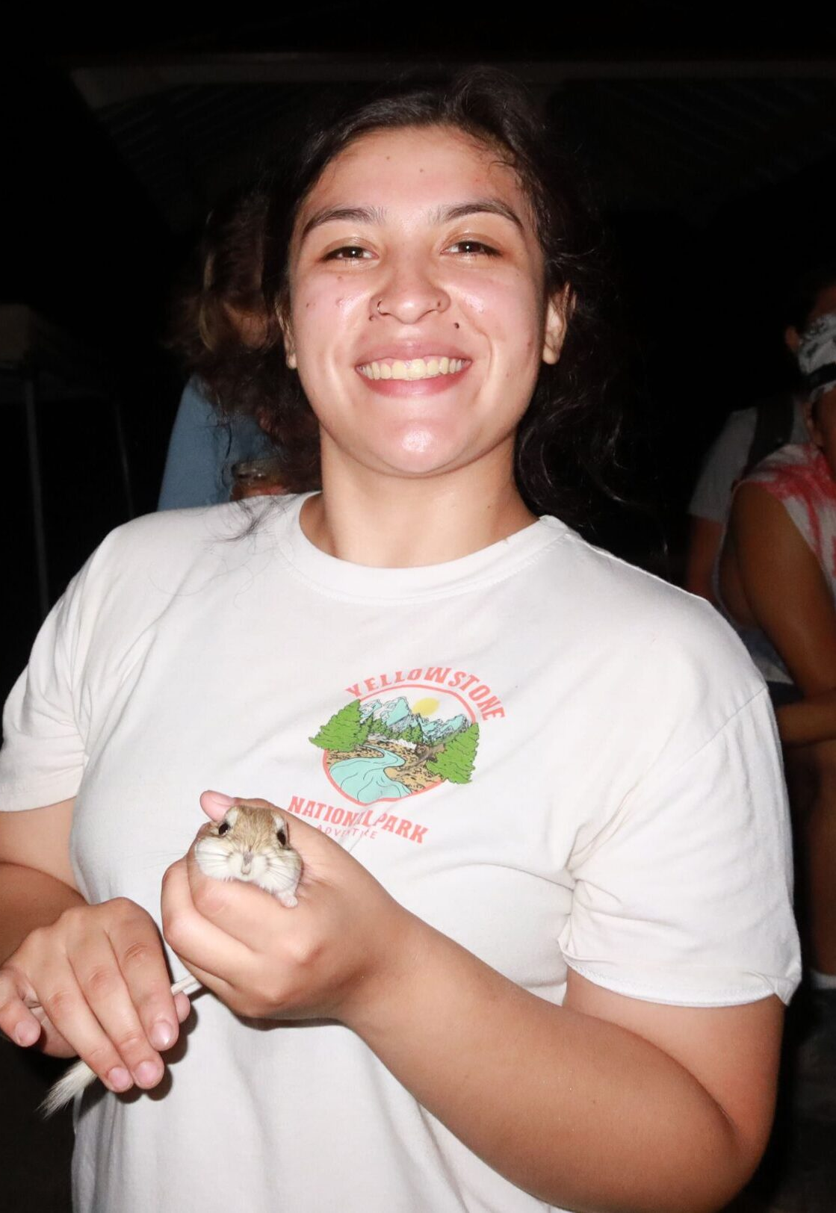
Future directions
Bringing rotifer size into the equation
Evolution in response to competition (more evolution-mediated indirect effects)
Structural equation modeling
Vinnie Cannizzaro
Complimentary effects of diversity on competitive ability in rotifers
Investigate interactions among r, K, competition, and temperature
?
Breana Morales

Slide 28
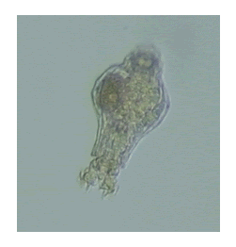
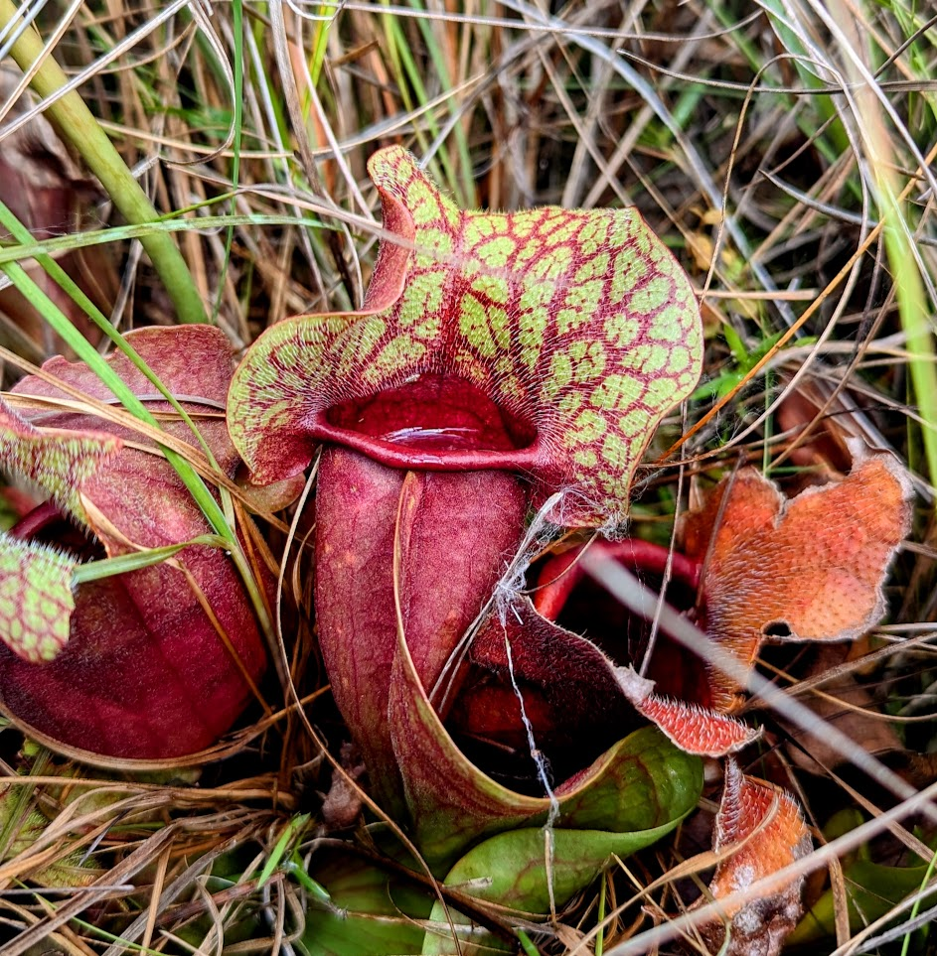
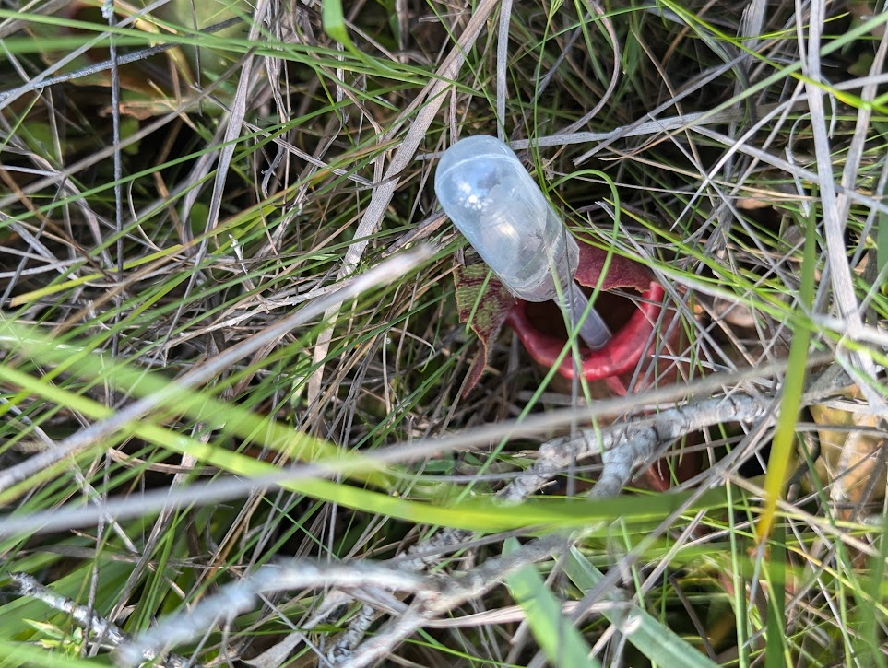

Questions?
Acknowledgements
Funding
Undergraduates Vinnie Cannizzaro and Breana Morales
Committee members Drs. Robert Espinoza and Bruno Pernet
Support staff Mark Harris
Sample collection help Dr. Tom Miller
CSUN Office of Graduate Studies
Thesis Support Grant

Slide 29
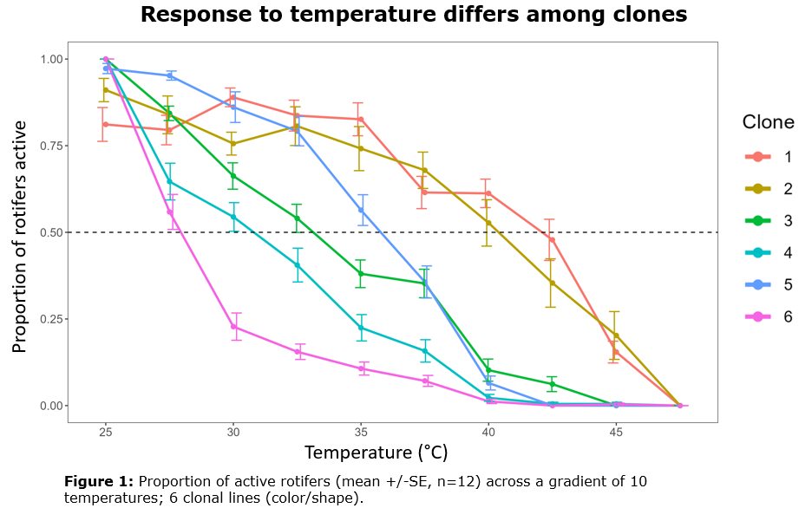

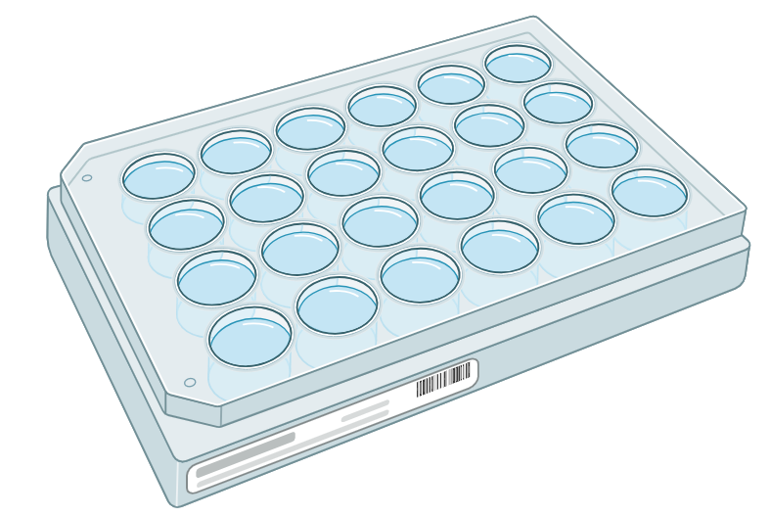
H. rosa clones differ in their response to temperature
Thermal tolerance
Time (h)
0
1
2
3
4
5
6
7
8
9
Active
Encysted
vs
25
30
35
40
45
Temperature (°C)

Slide 30
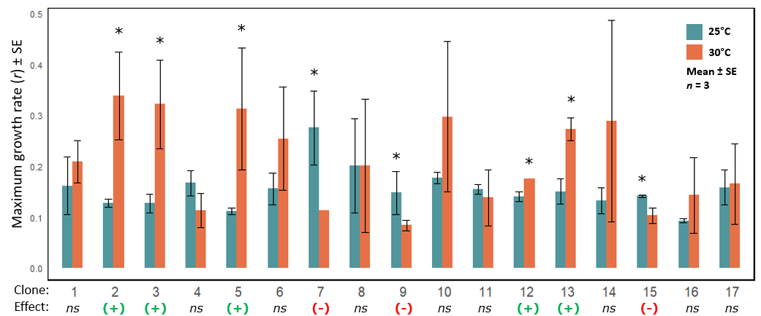
H. rosa clones differ in their response to temperature
Maximum growth rate

